Slide 1
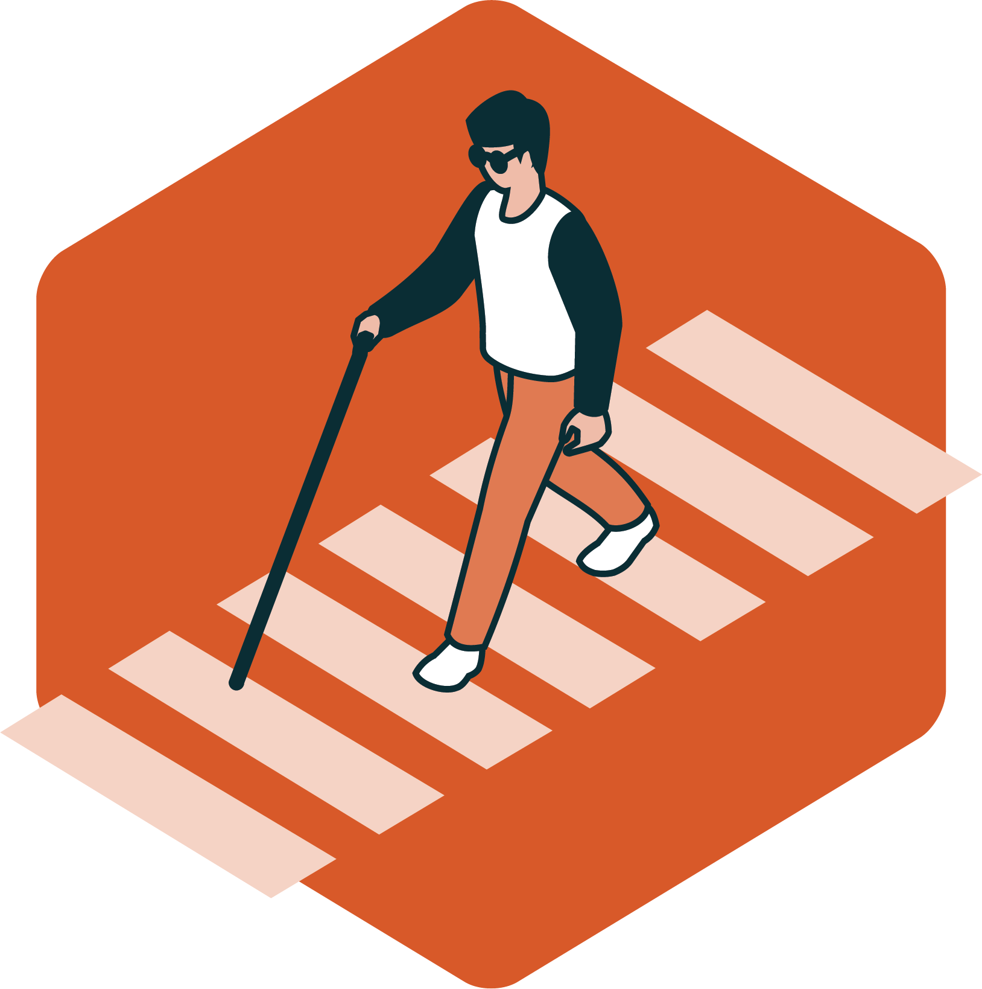
SAFETY PERFORMANCE MEASURES
Data Reporting Year 2024

Slide 2
FHWA’s 5 Safety Performance Measures
Regional 5-Year Rolling Averages of:
Number of Fatalities
Rate of Fatalities per 100 million VMT (Vehicle Miles Traveled)
Number of Serious Injuries
Rate of Serious Injuries per 100 million VMT
Number of Non-motorized Fatalities & Serious Injuries
1
2
3
4
5

Slide 3
How is crash data reported and used?
Local/Regional
State
Federal
Provides statewide raw crash data to:
Local Jurisdictions
Reports to
FHMPO
KDOT
Sets own statewide targets, reports targets to:
FHWA
Filters data for MPO area, reports targets to:
Local jurisdictions can use FHMPO’s crash data to identify problem areas and plan future safety projects.
FHMPO evaluates safety data, sets regional targets, and reports data to member jurisdictions and KDOT.
FHMPO reports targets and metrics to KDOT. KDOT then includes these targets and metrics in the state’s report to FHWA.
If statewide targets are not met (or significant progress reached), FHWA requires the state to 1) set aside a portion of obligated funds ONLY for highway safety projects and 2) submit annual action plan for reaching targets.

Slide 4
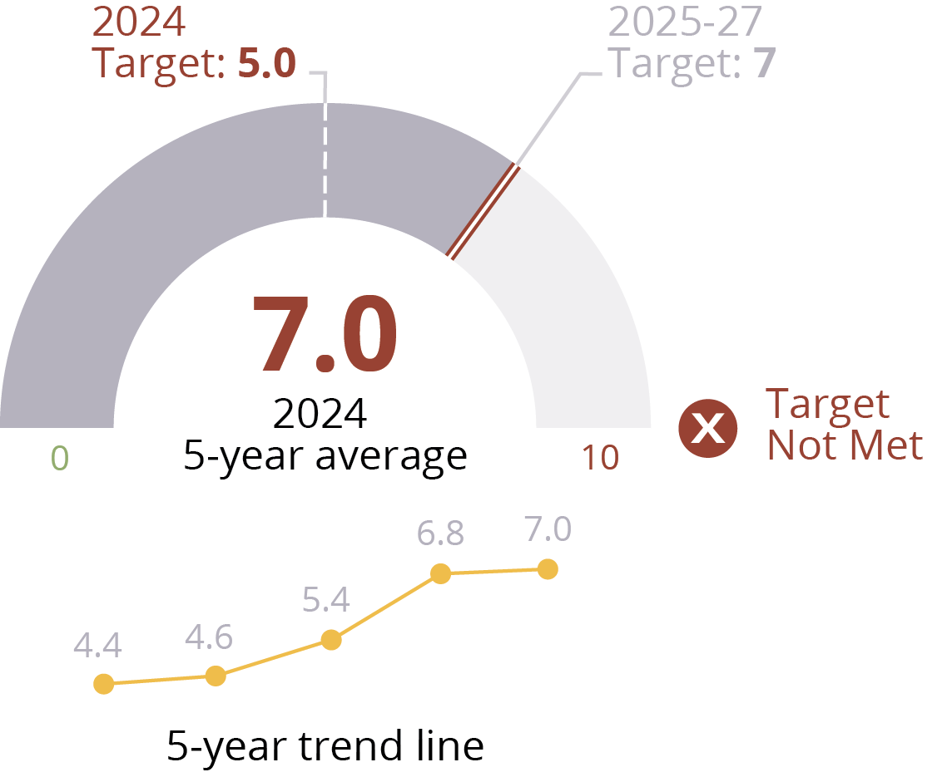
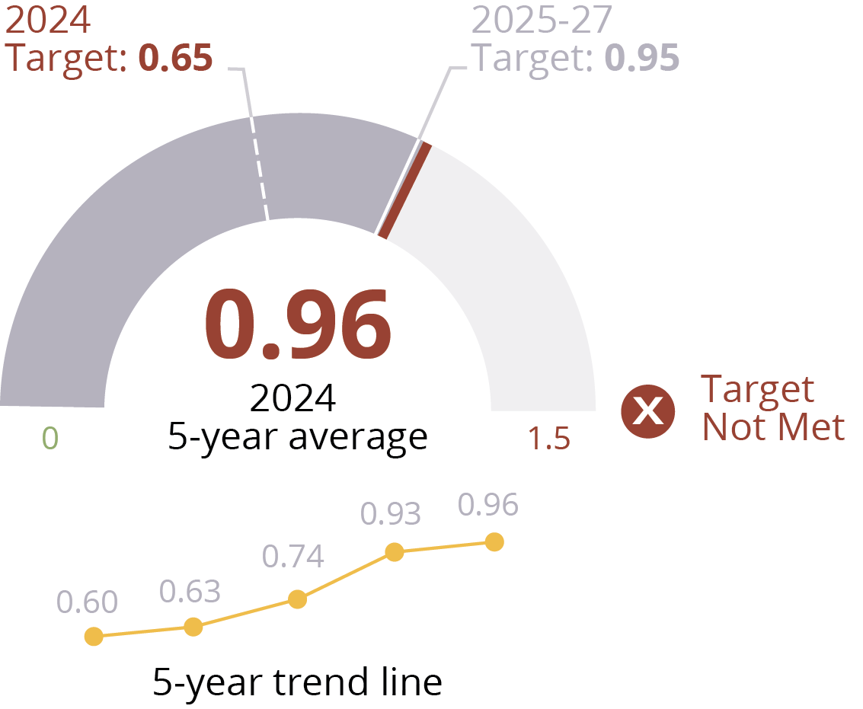
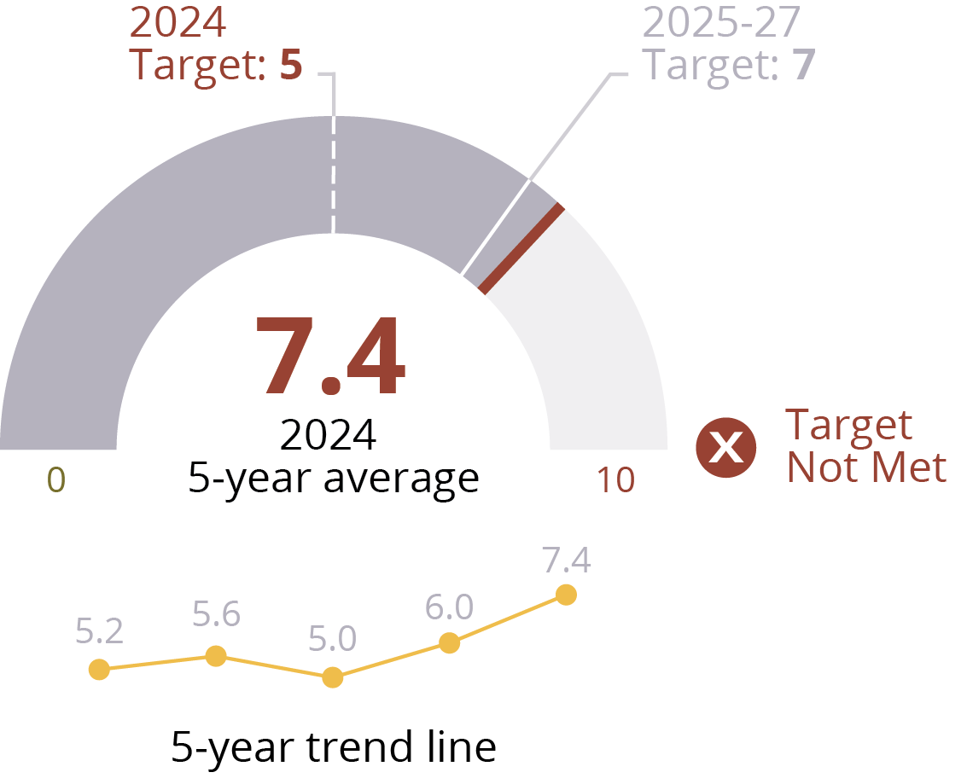
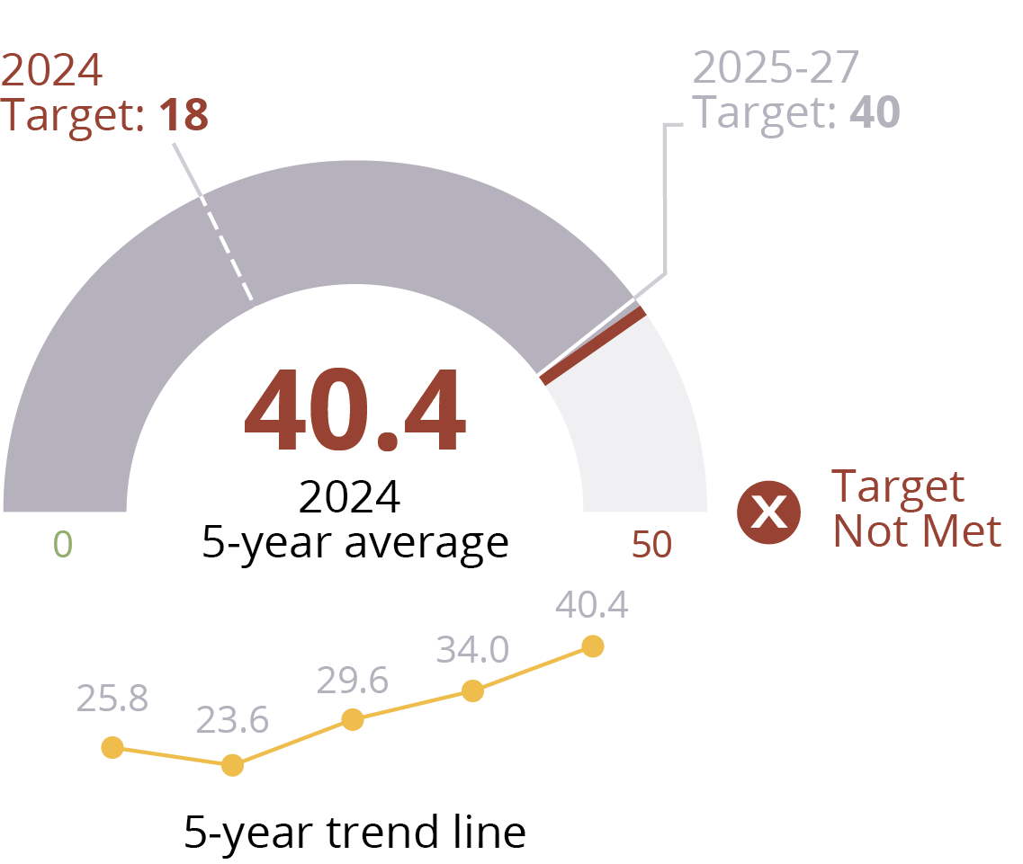
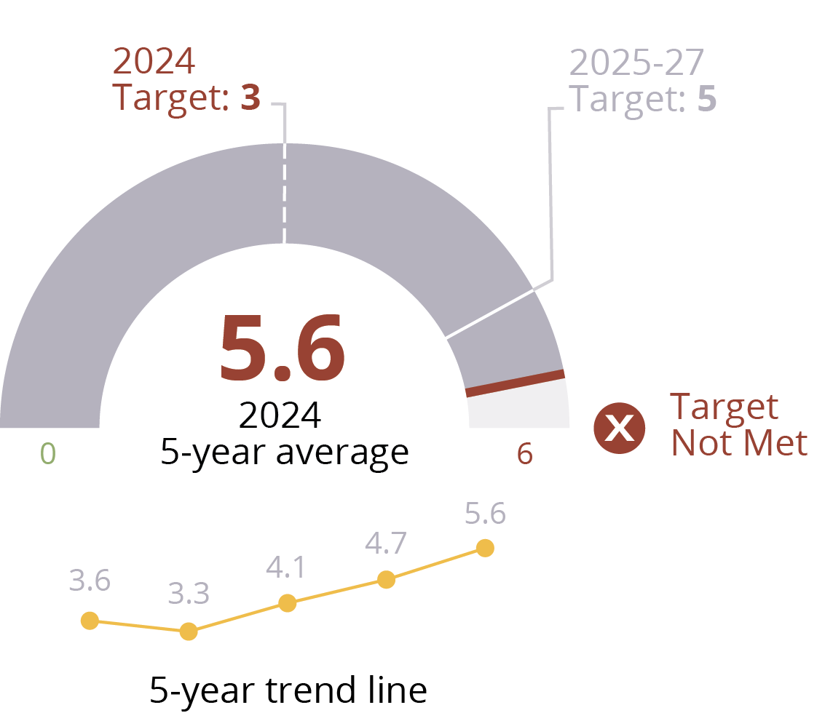
PM1: Vehicle fatalities
Safety performance measures: Summary
PM2: Vehicle fatalities/100m VMT
PM5: # non-motorized fatal + SI
PM3: # serious injuries
PM4: serious injuries/100M VMT

Slide 5
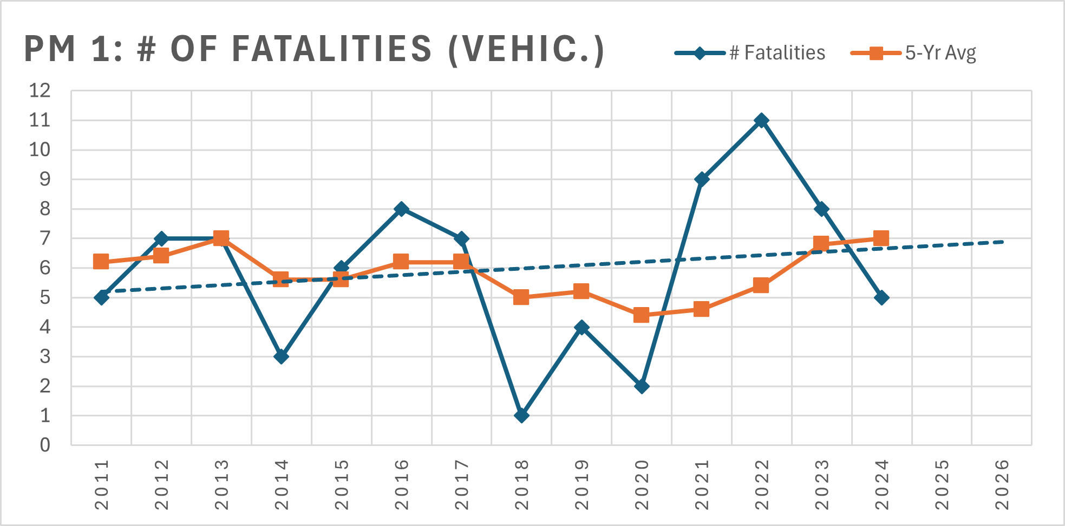
Target : # of Vehicle Fatalities
1
X
Off Target

Slide 6
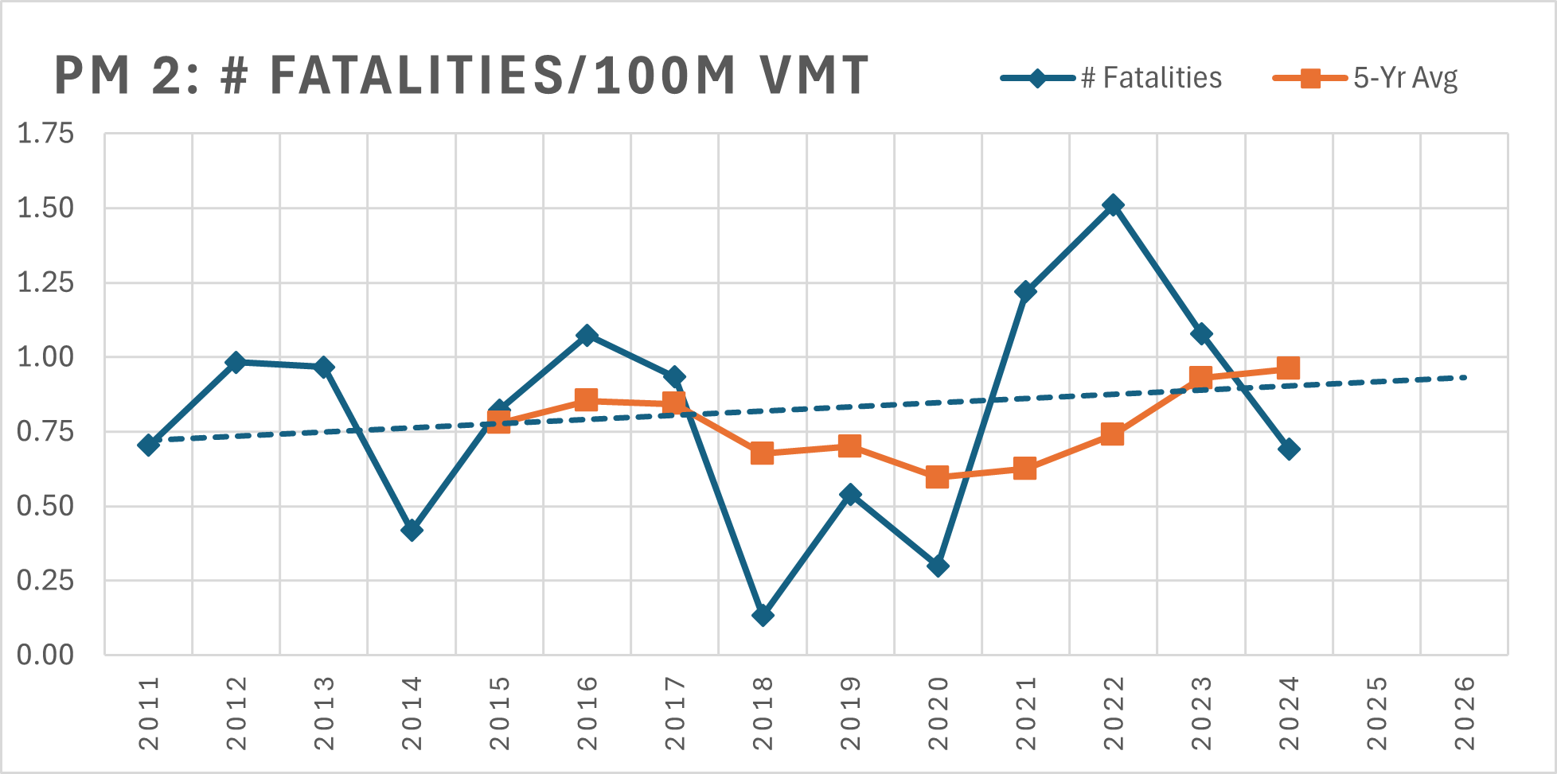
Target : Rate of Vehicle Fatalities p. 100m VMT
2
X
Off Target
* VMT details found in Appendix A

Slide 7
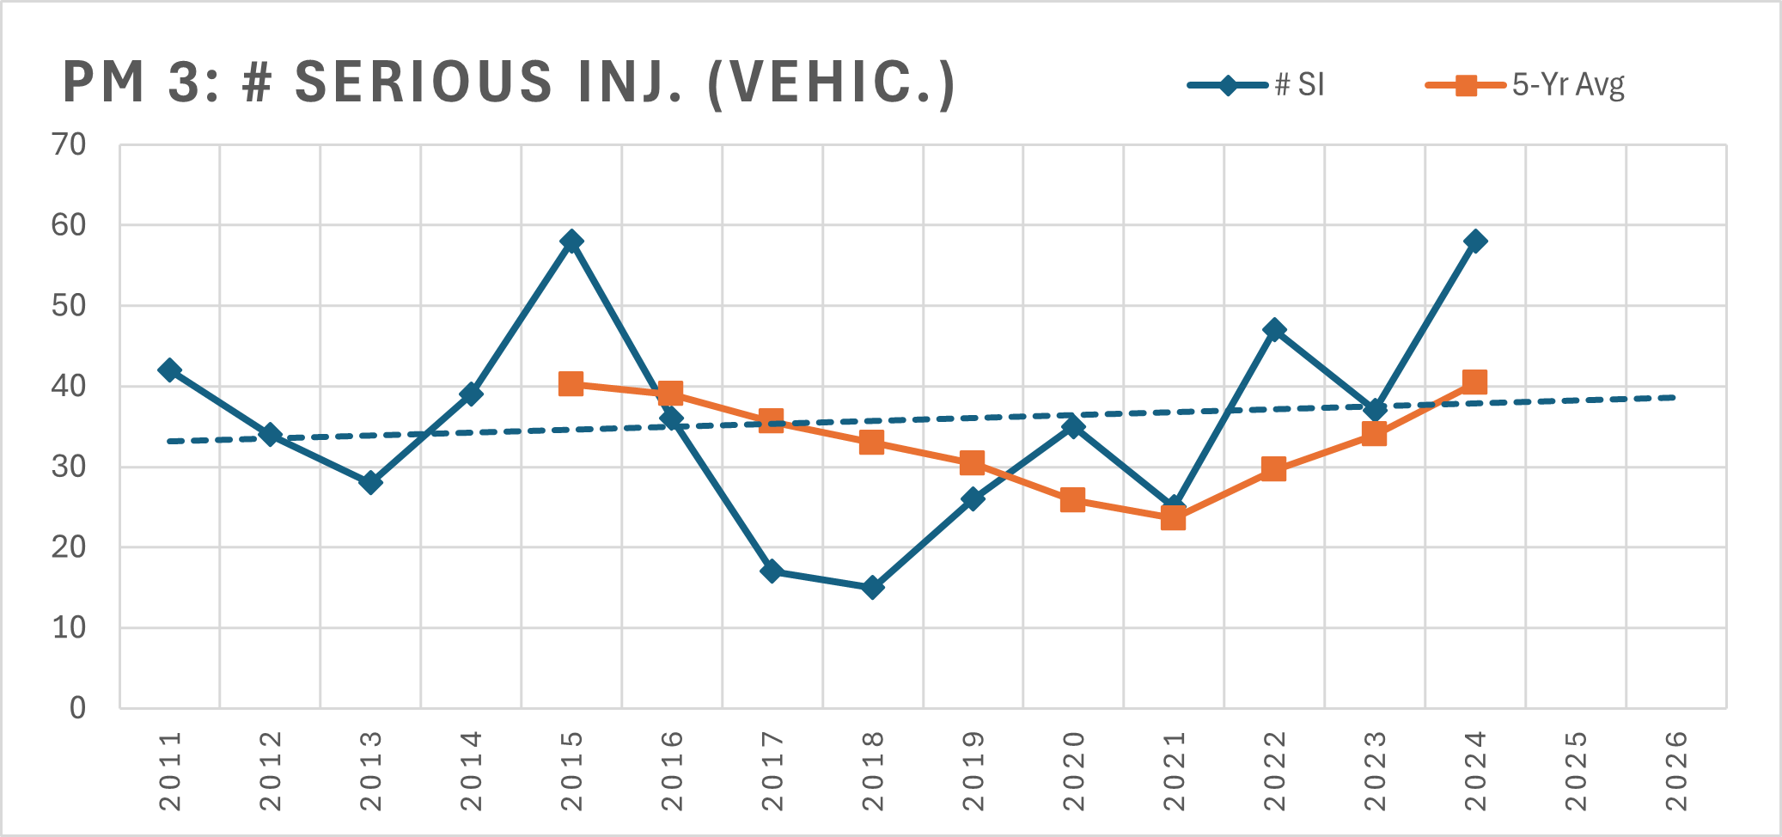
Target : # of Serious Injuries
3
X
Off Target

Slide 8
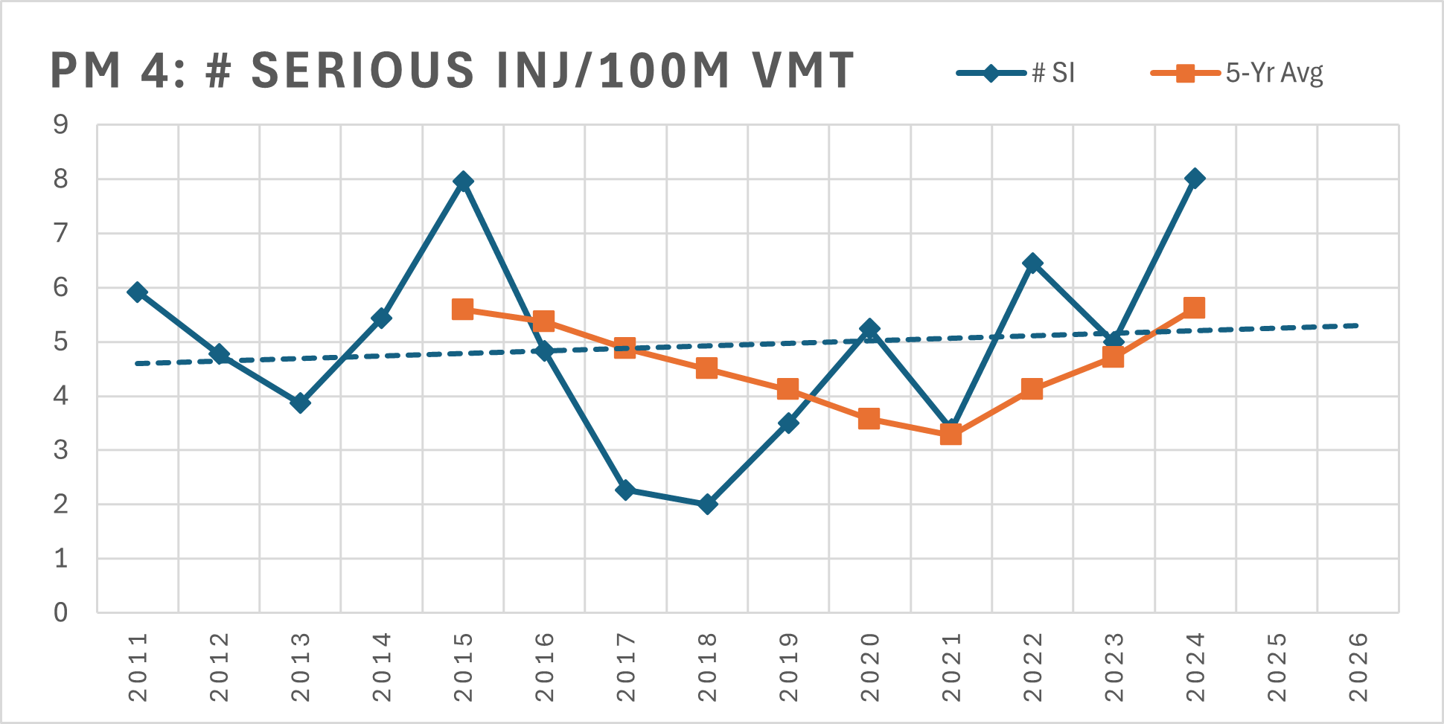
Target : Rate of Serious Injuries p. 100m VMT
4
X
Off Target
* VMT details found in Appendix A

Slide 9
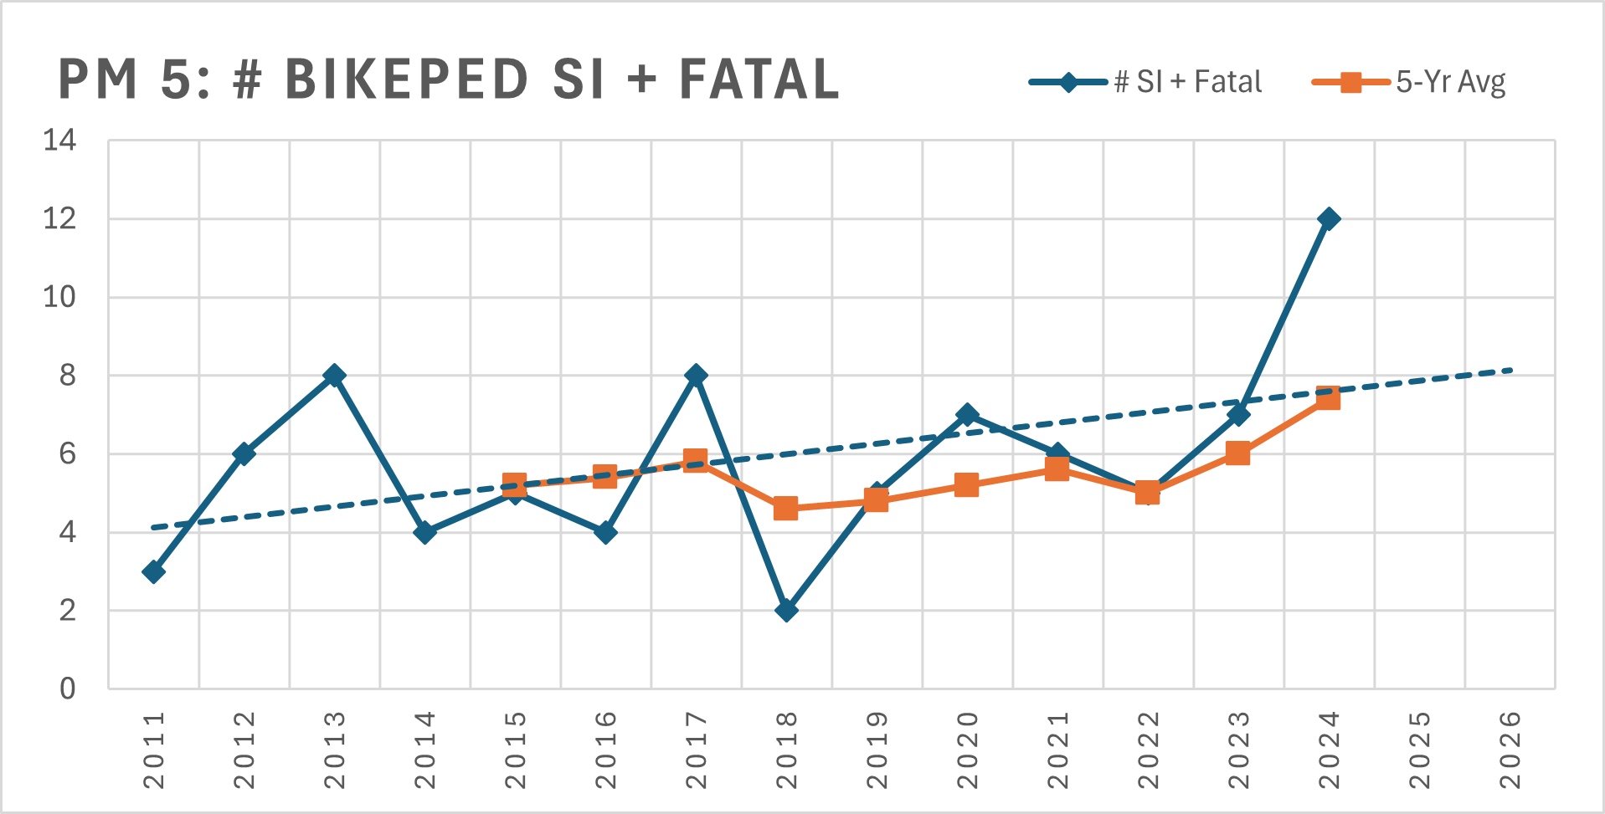
Target : # of Non-vehicular fatalities & Serious Injuries
5
X
Off Target

Slide 10
Target Summary
Performance Measure |  | 2024 5-Year Avg | 2024 Targets (set in 2018) | Future Targets
 | # of Vehicular Fatalities | 7 | 5 | 2025: 7 2026: 7 2027: 7
 | Rate of Fatalities per 100 million VMT | 0.96 | 0.65 | 2025: 0.95 2026: 0.95 2027: 0.95
 | # of Vehicular Serious Injuries | 40.4 | 18 | 2025: 40 2026: 40 2027: 40
 | Rate of Serious Injuries per 100 million VMT | 5.6 | 3.0 | 2025: 5 2026: 5 2027: 5
 | # of Non-Vehicular Fatalities & Serious Injuries | 7.4 | 5 | 2025: 7 2026: 7 2027: 7
1
X
Off Target
X
2
Off Target
3
X
Off Target
X
4
Off Target
X
5
Off Target

Slide 11
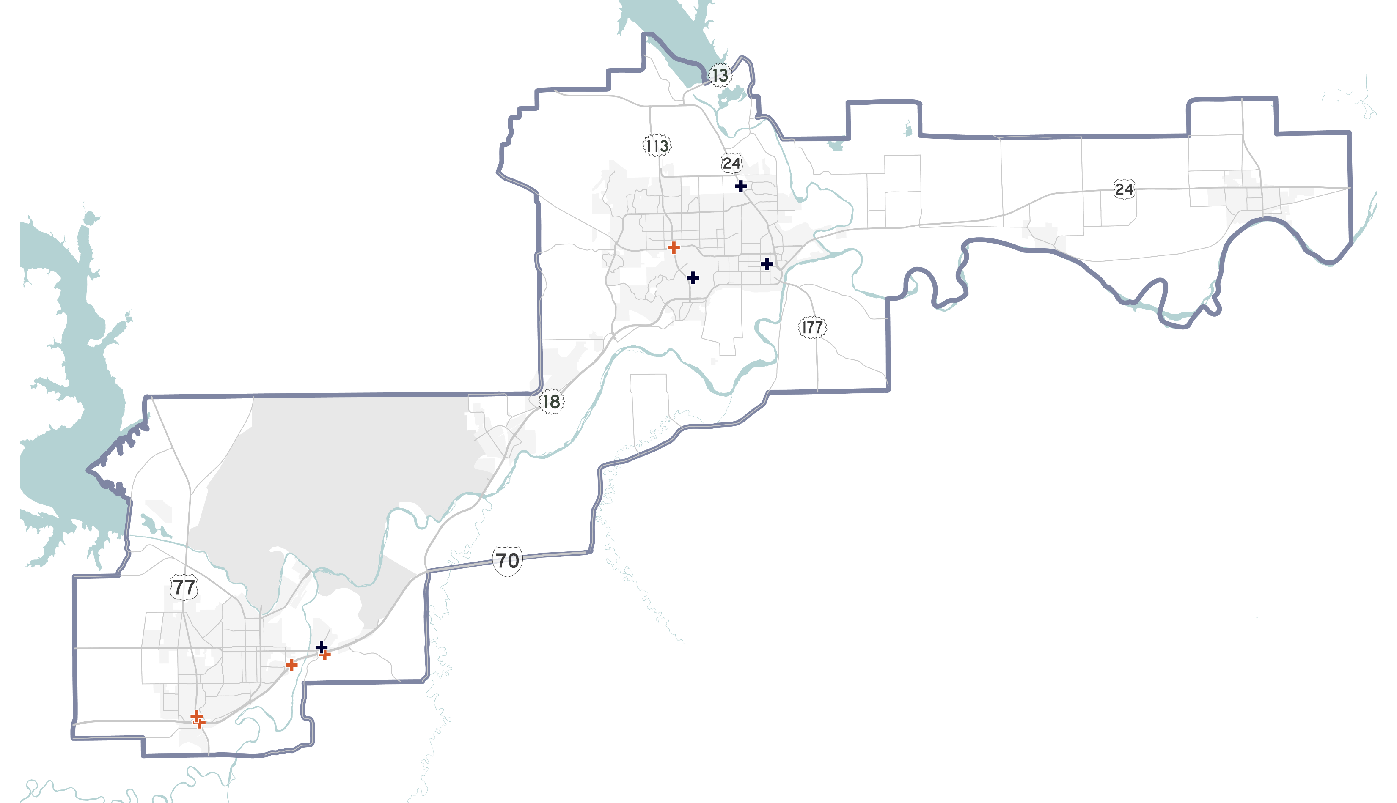
Crash Maps: 2024 fatalities
5 Vehicle Occupants
+
4 Cyclists or Pedestrians
=
9 Fatalities in 2024

Slide 12
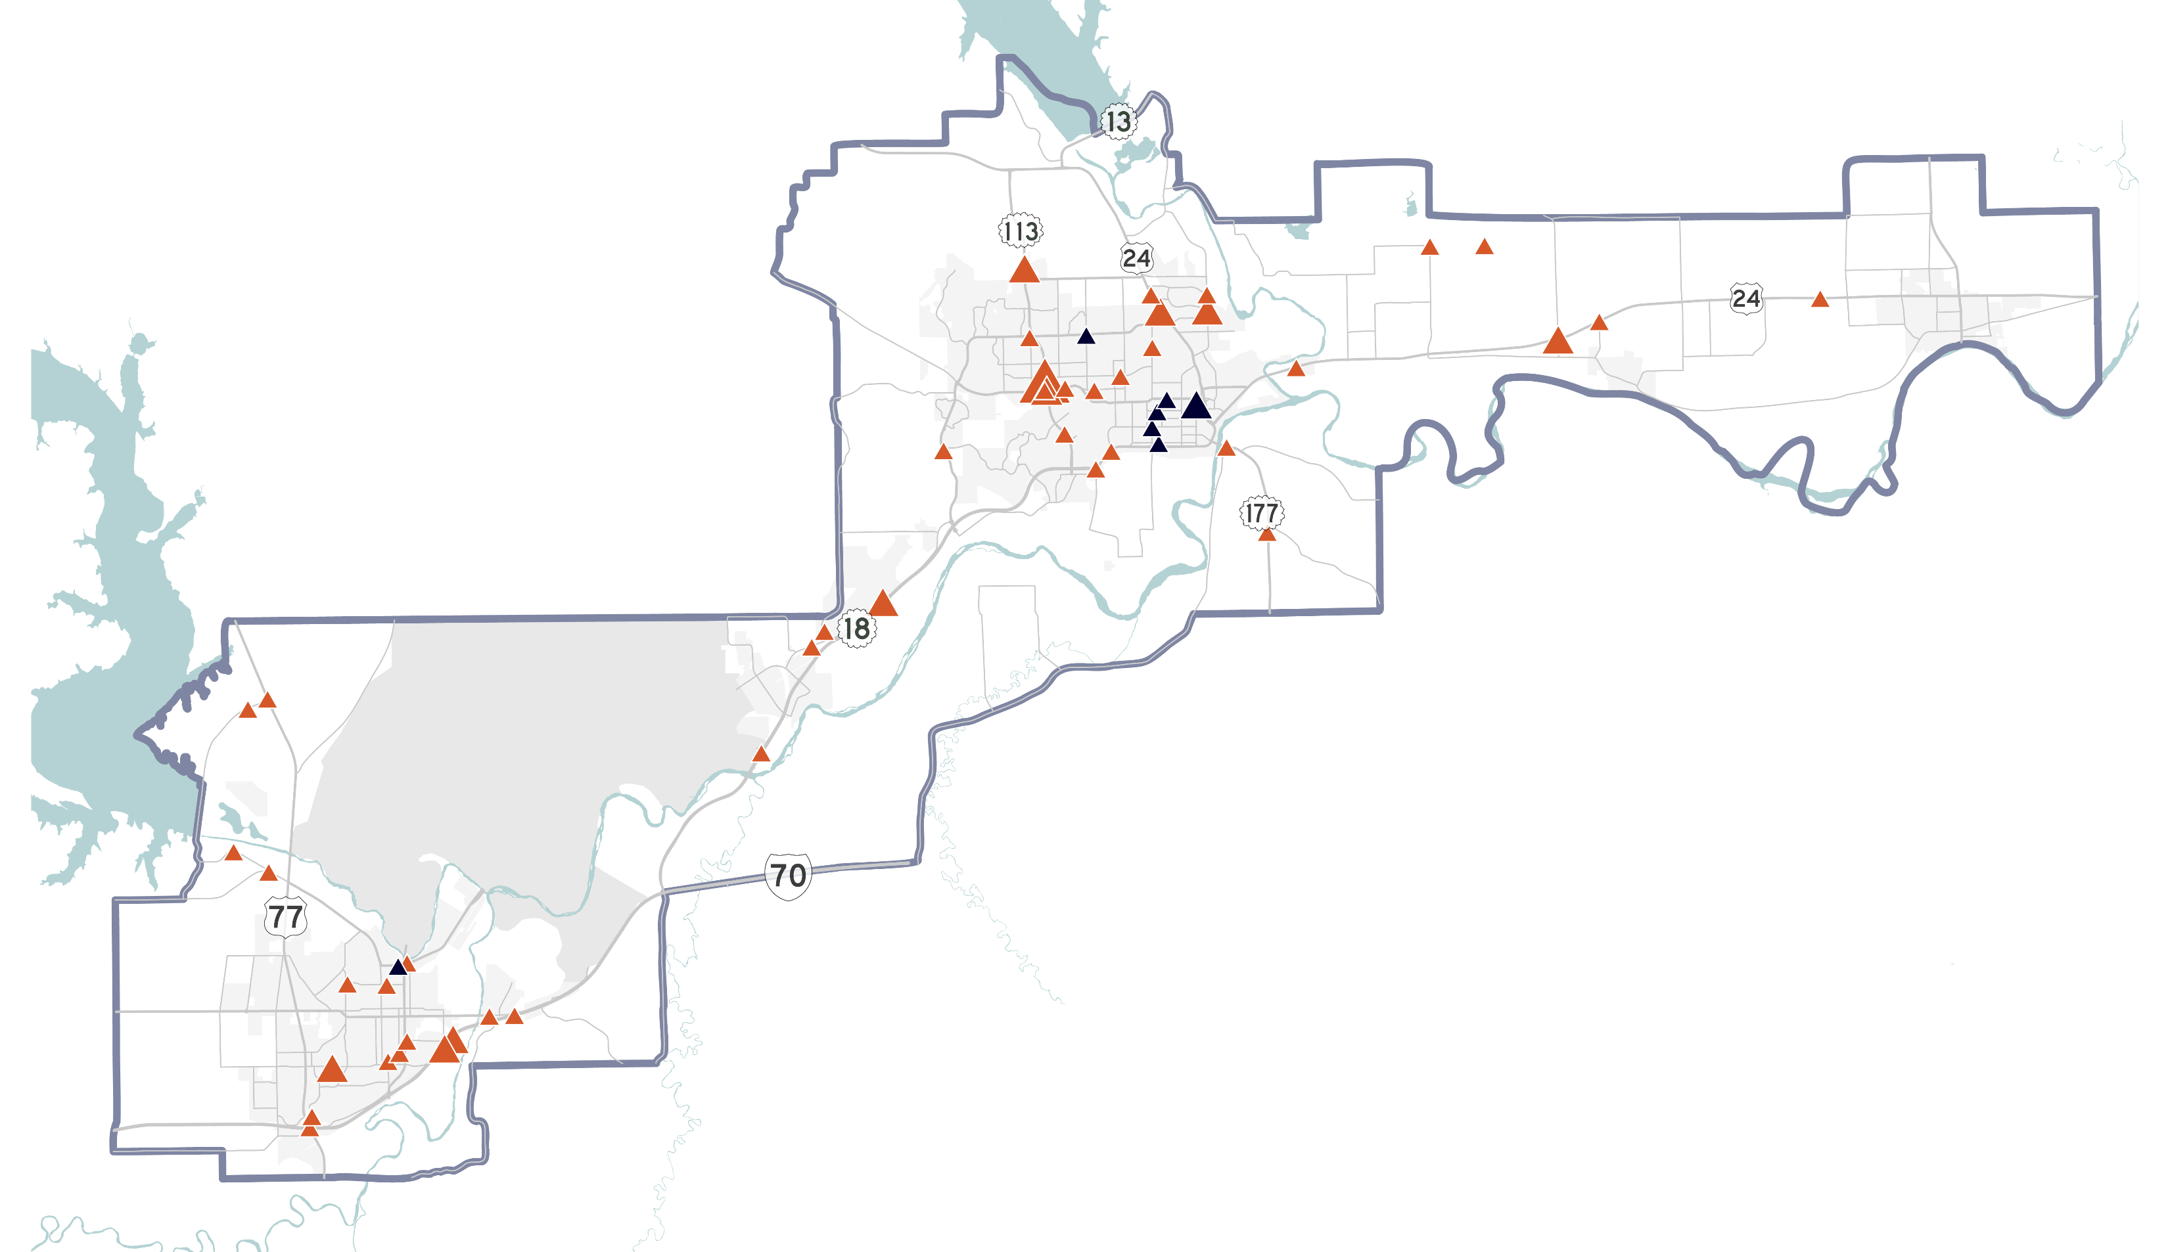
Crash Maps: 2024 Serious injuries
Vehicle Occupant
Ped-Bike
58 Vehicle Occupants
+
8 Cyclists or Pedestrians
=
66 Serious Injuries in 2024

Slide 13
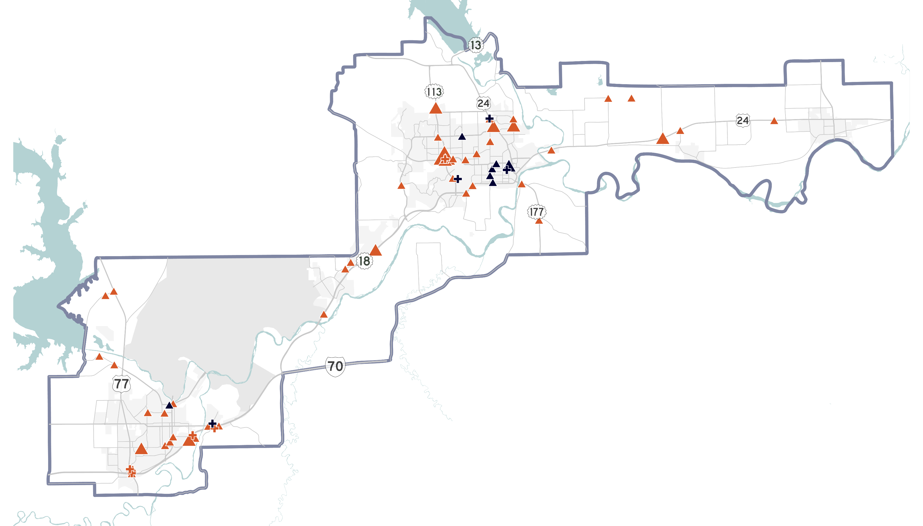
Serious injuries + fatalities
Vehicle Occupant
Cyclist or Pedestrian
37 Occupants
6 Bike-Ped
75 Fatalities + Serious Injuries in 2024

Slide 14
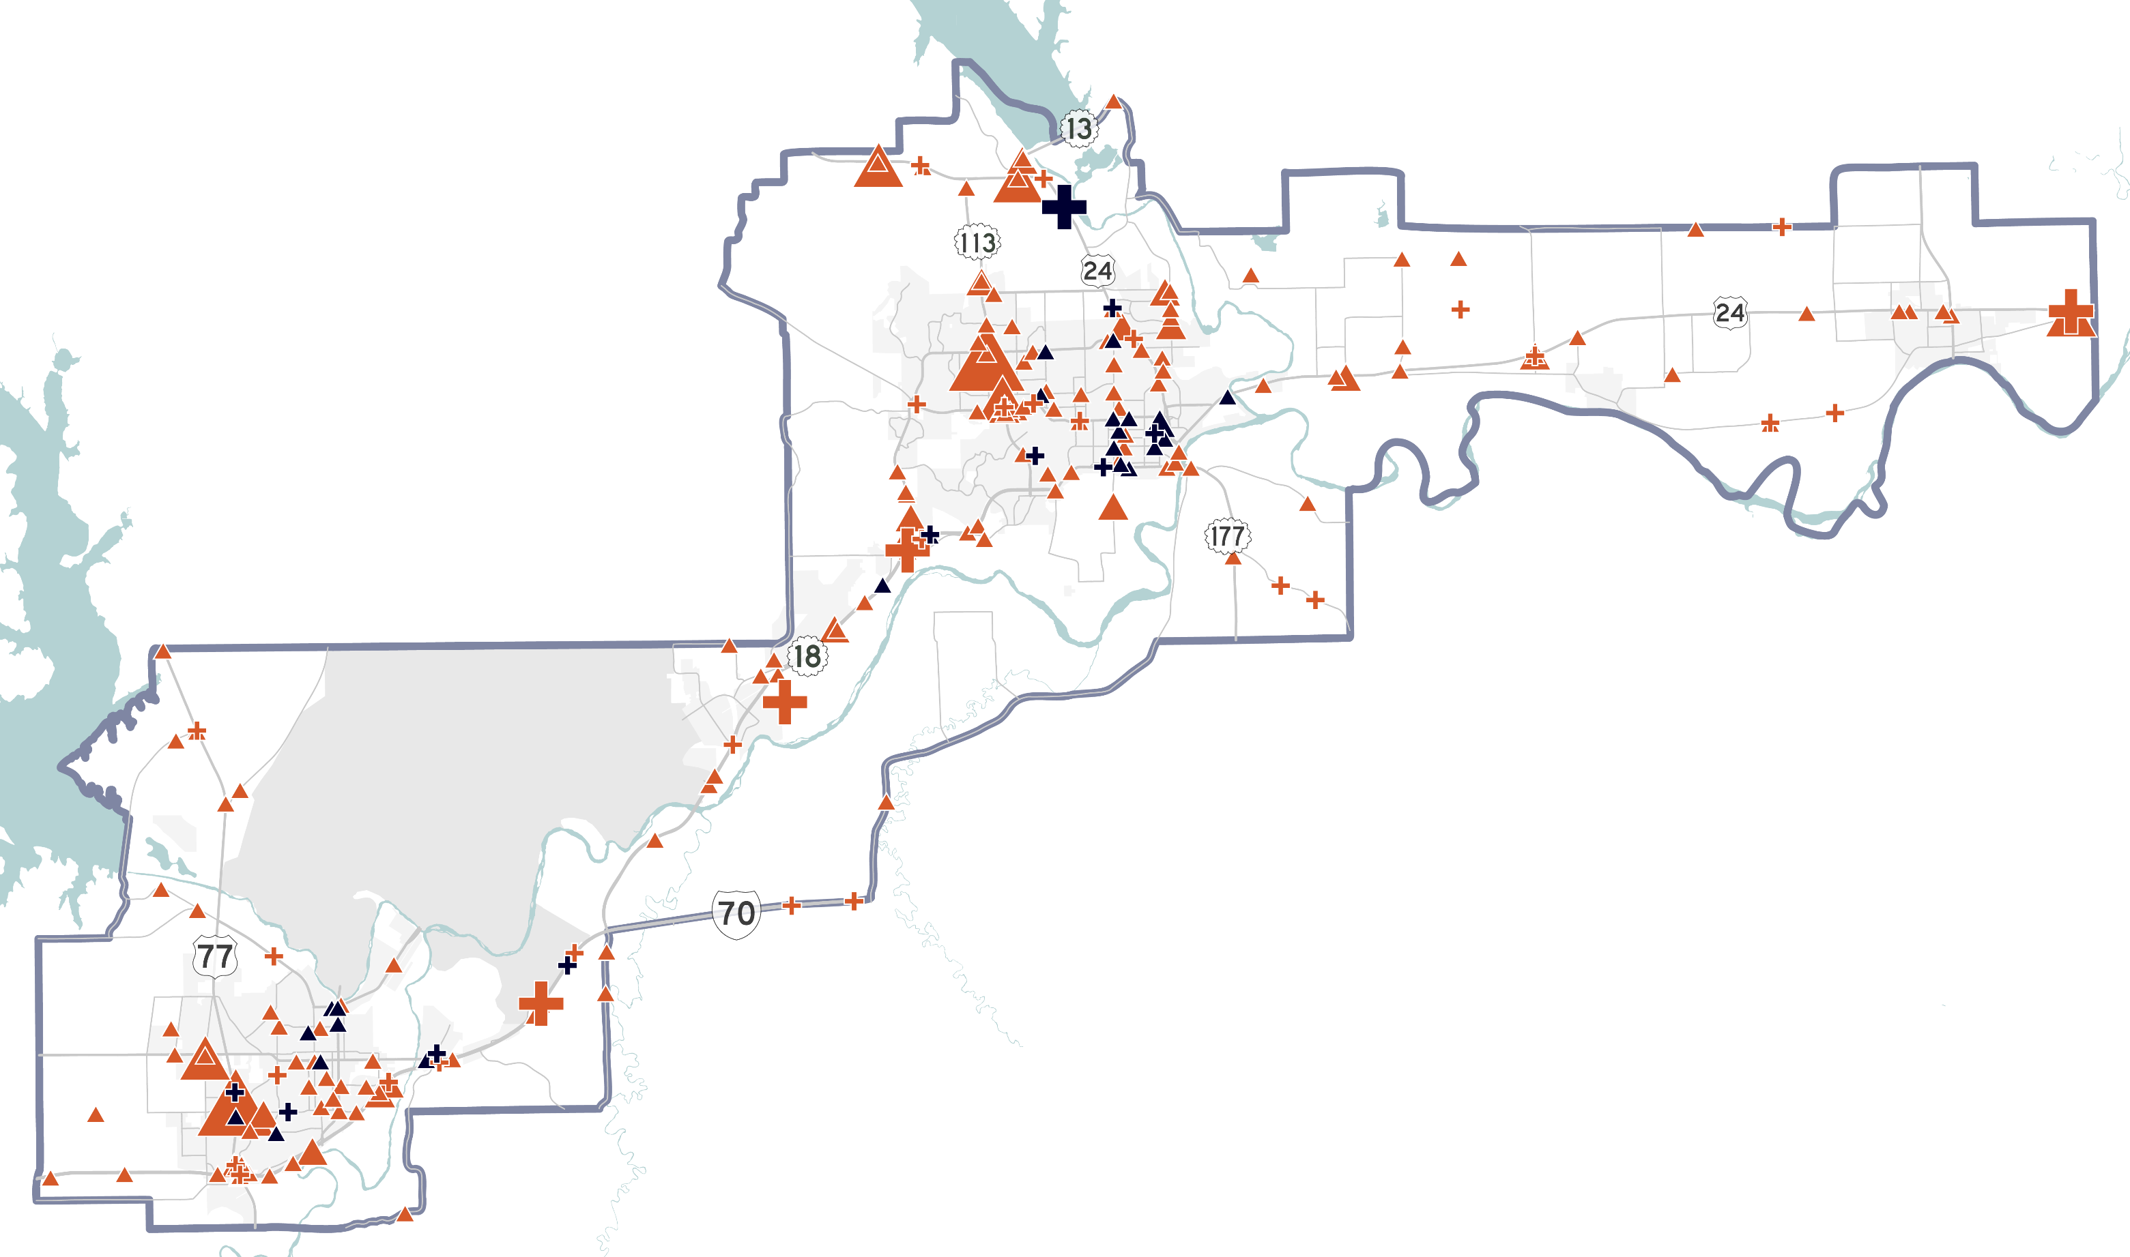
Fatal/serious inj. Crashes: 2020-2024
Fatalities
35 Vehicle Occupants
+
11 Cyclists or Pedestrians
=
46 Fatalities 2020-2024
Serious Injuries
202 Vehicle Occupants
+
26 Cyclists or Pedestrians
=
228 Serious Injuries 2020-2024

Slide 15
Overall findings
VMT and number of vehicular fatalities (5) lowest since 2020
Non-motorized fatalities and serious injuries (12) are highest ever
Vehicular serious injuries (58) highest ever
Total serious injuries (66) highest ever
Total fatal + SI (75) highest ever

Slide 16
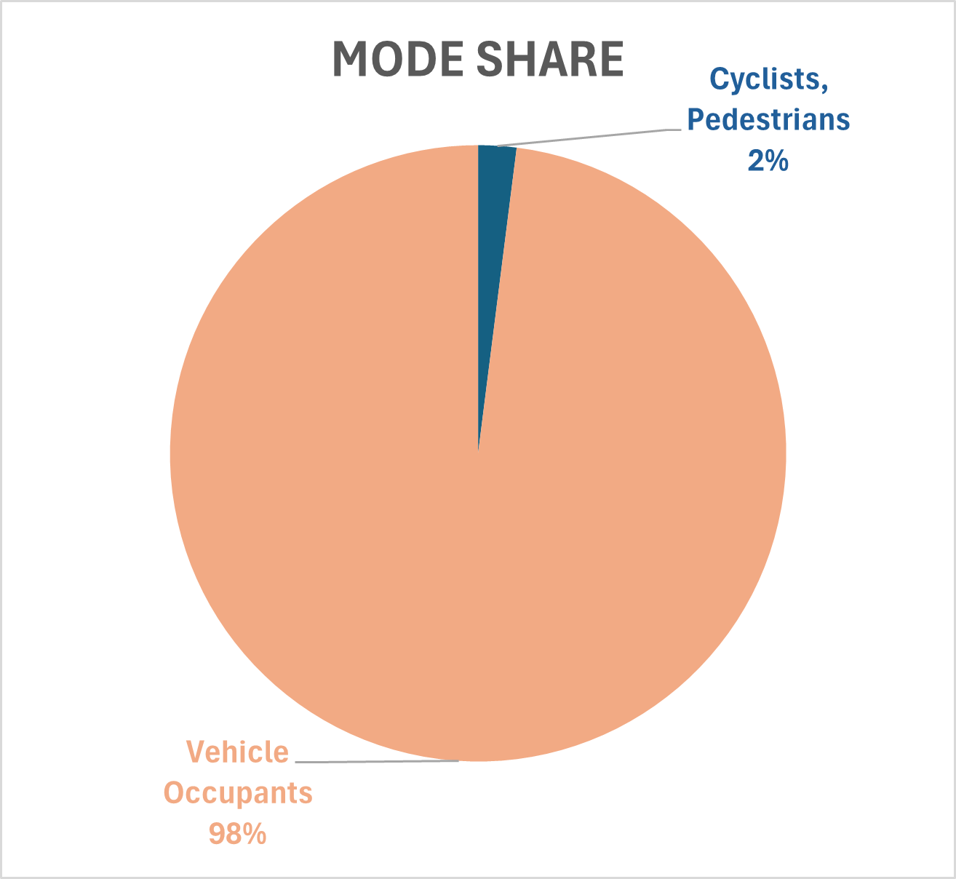
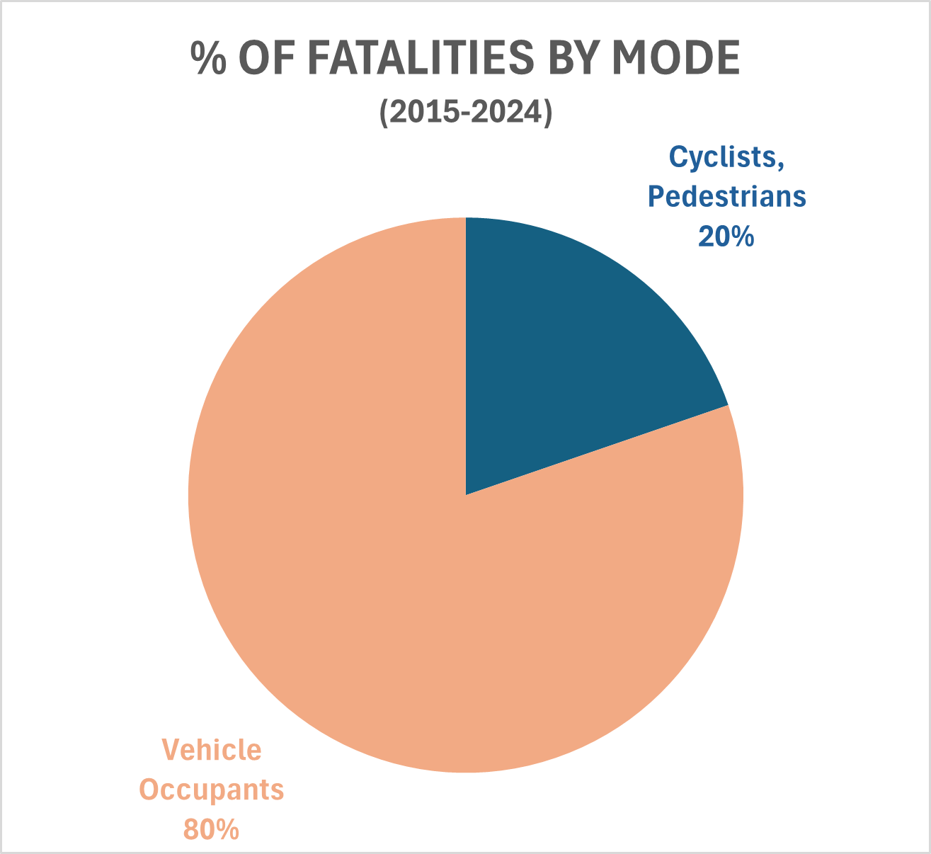
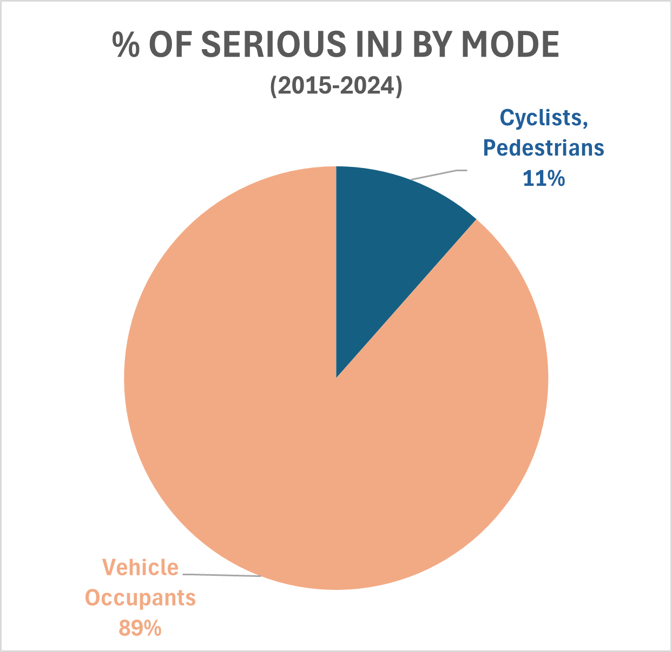



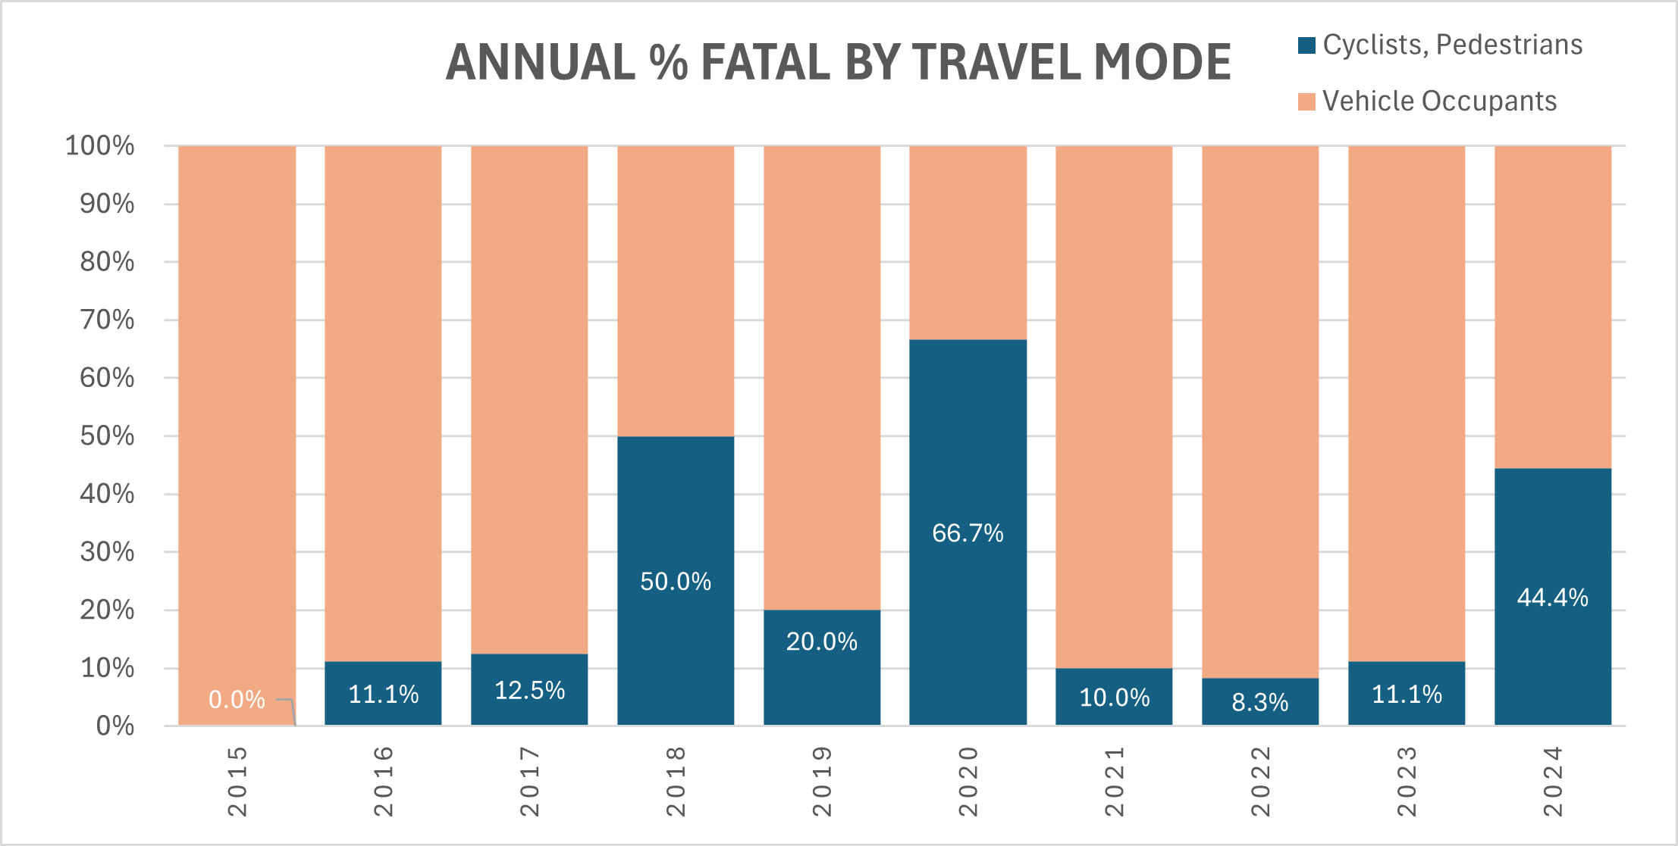
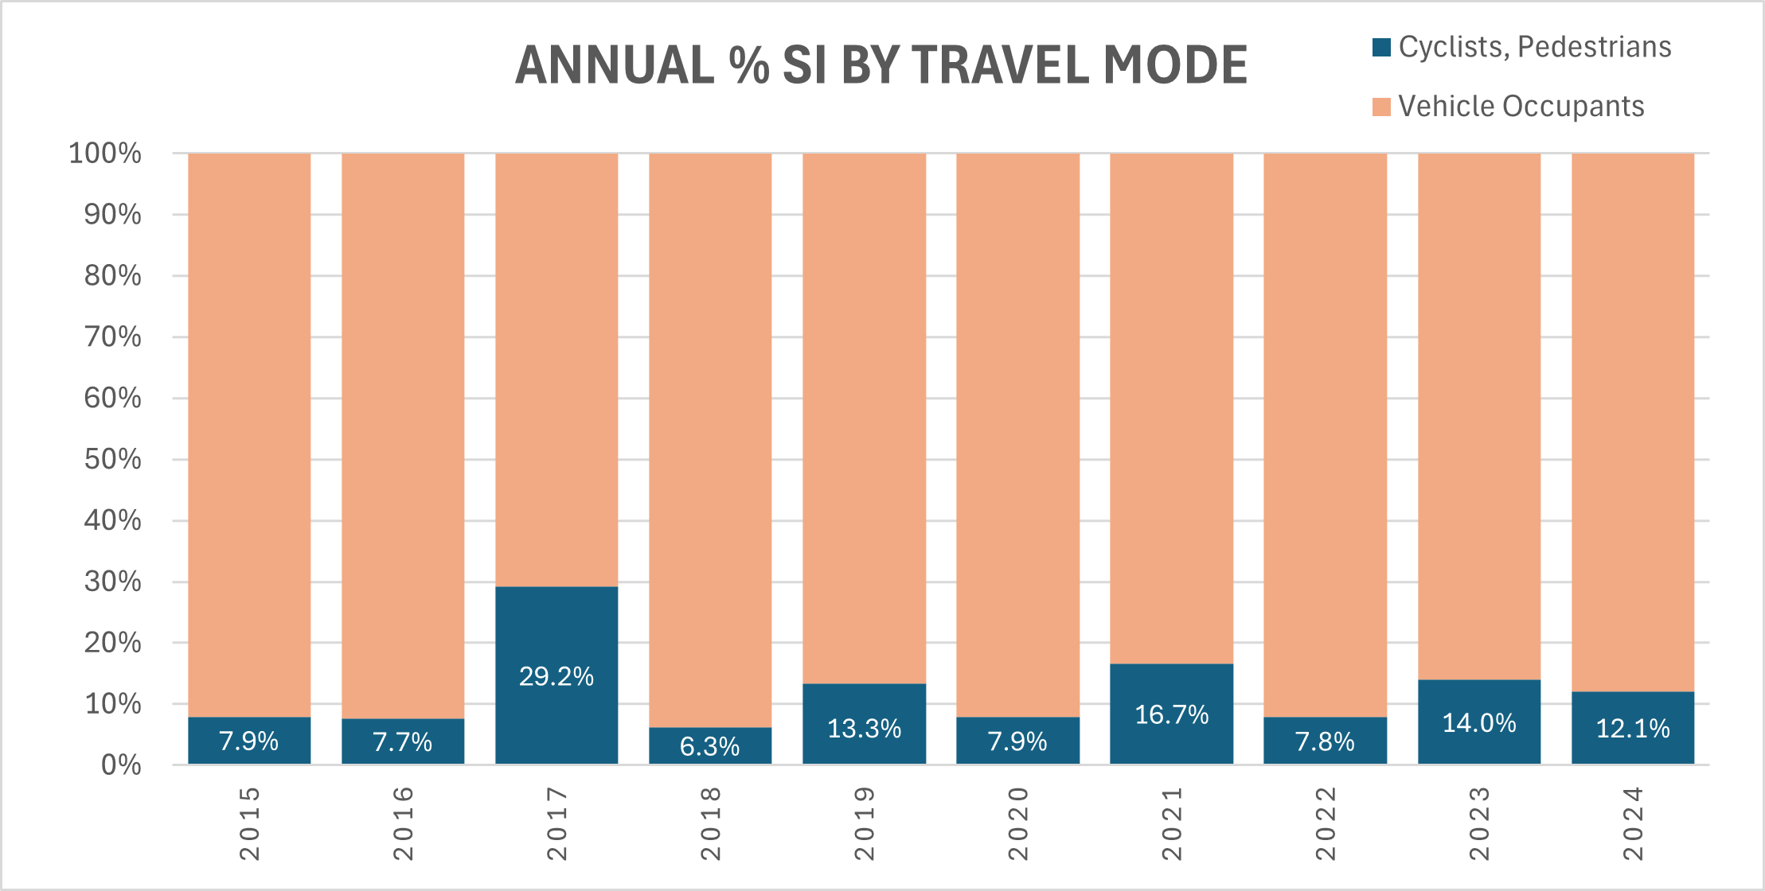
serious & fatal crashes by travel mode
Serious Injuries
Fatalities
20
83
46
354

Slide 17
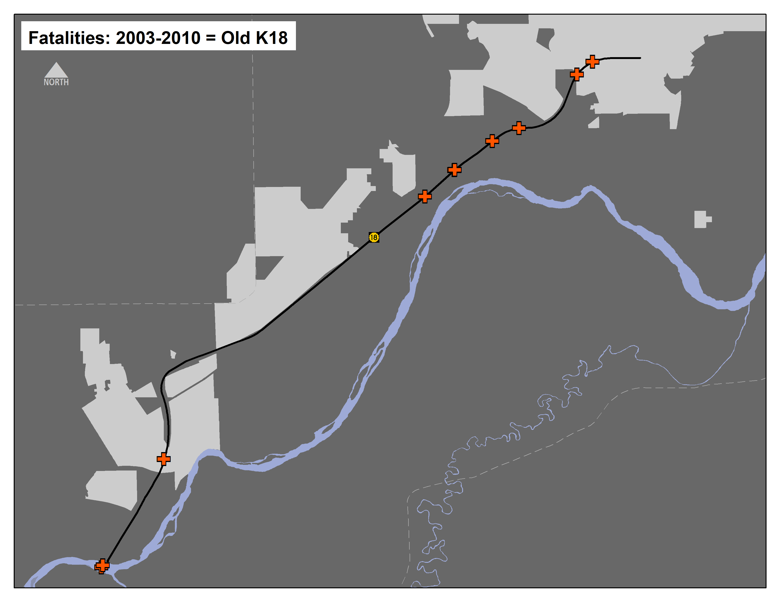
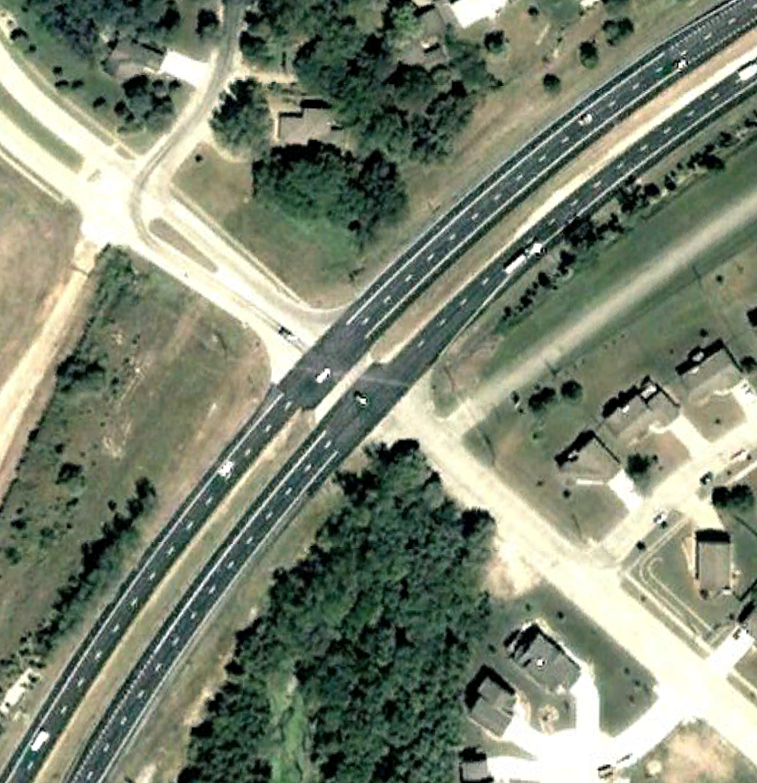
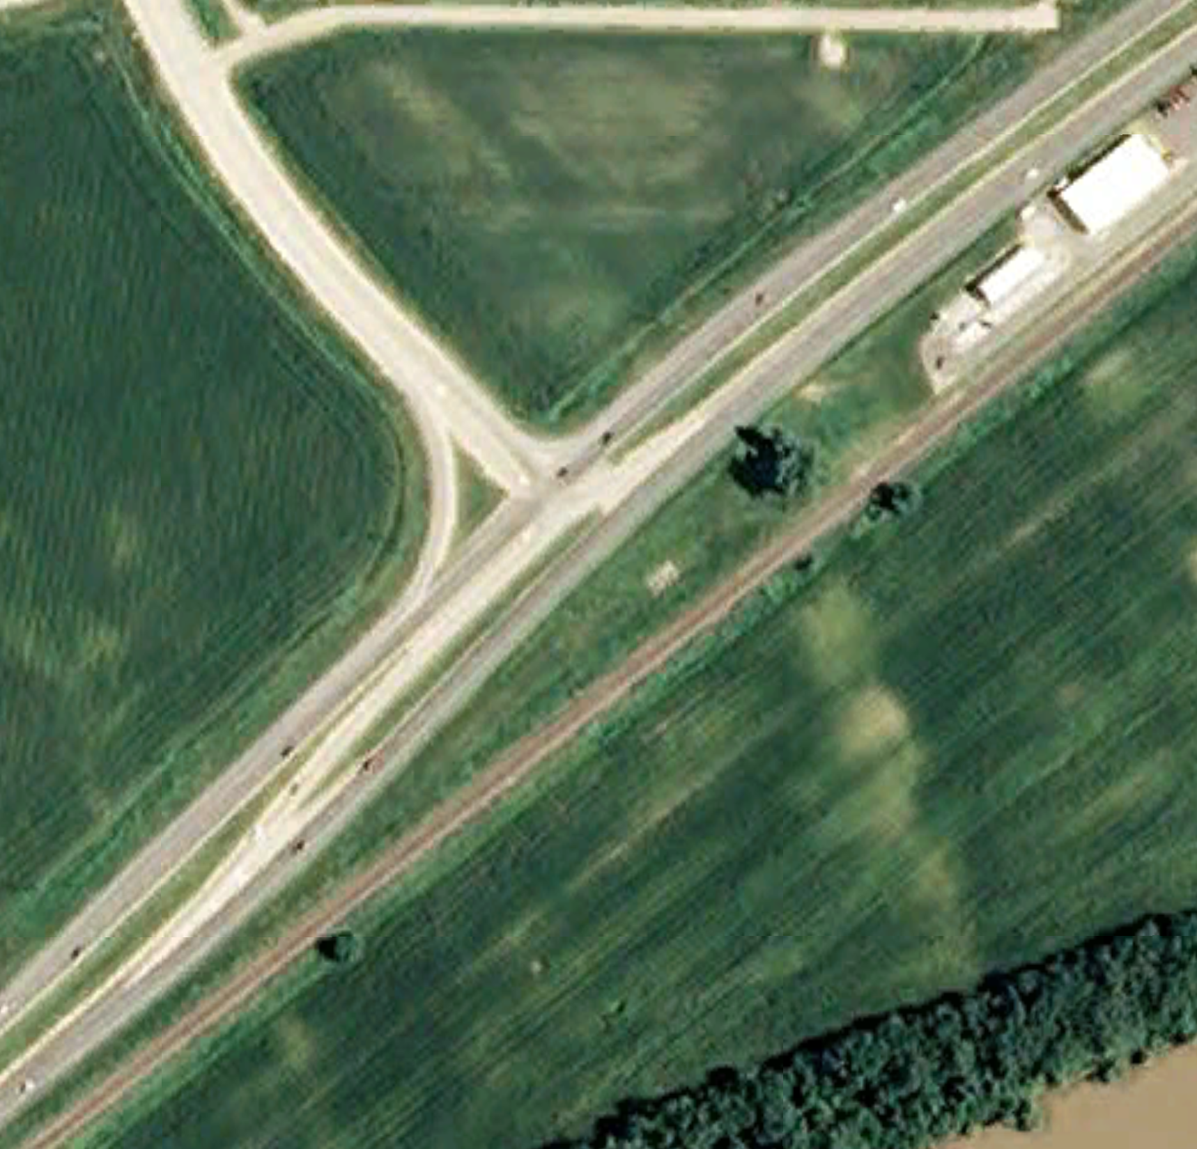
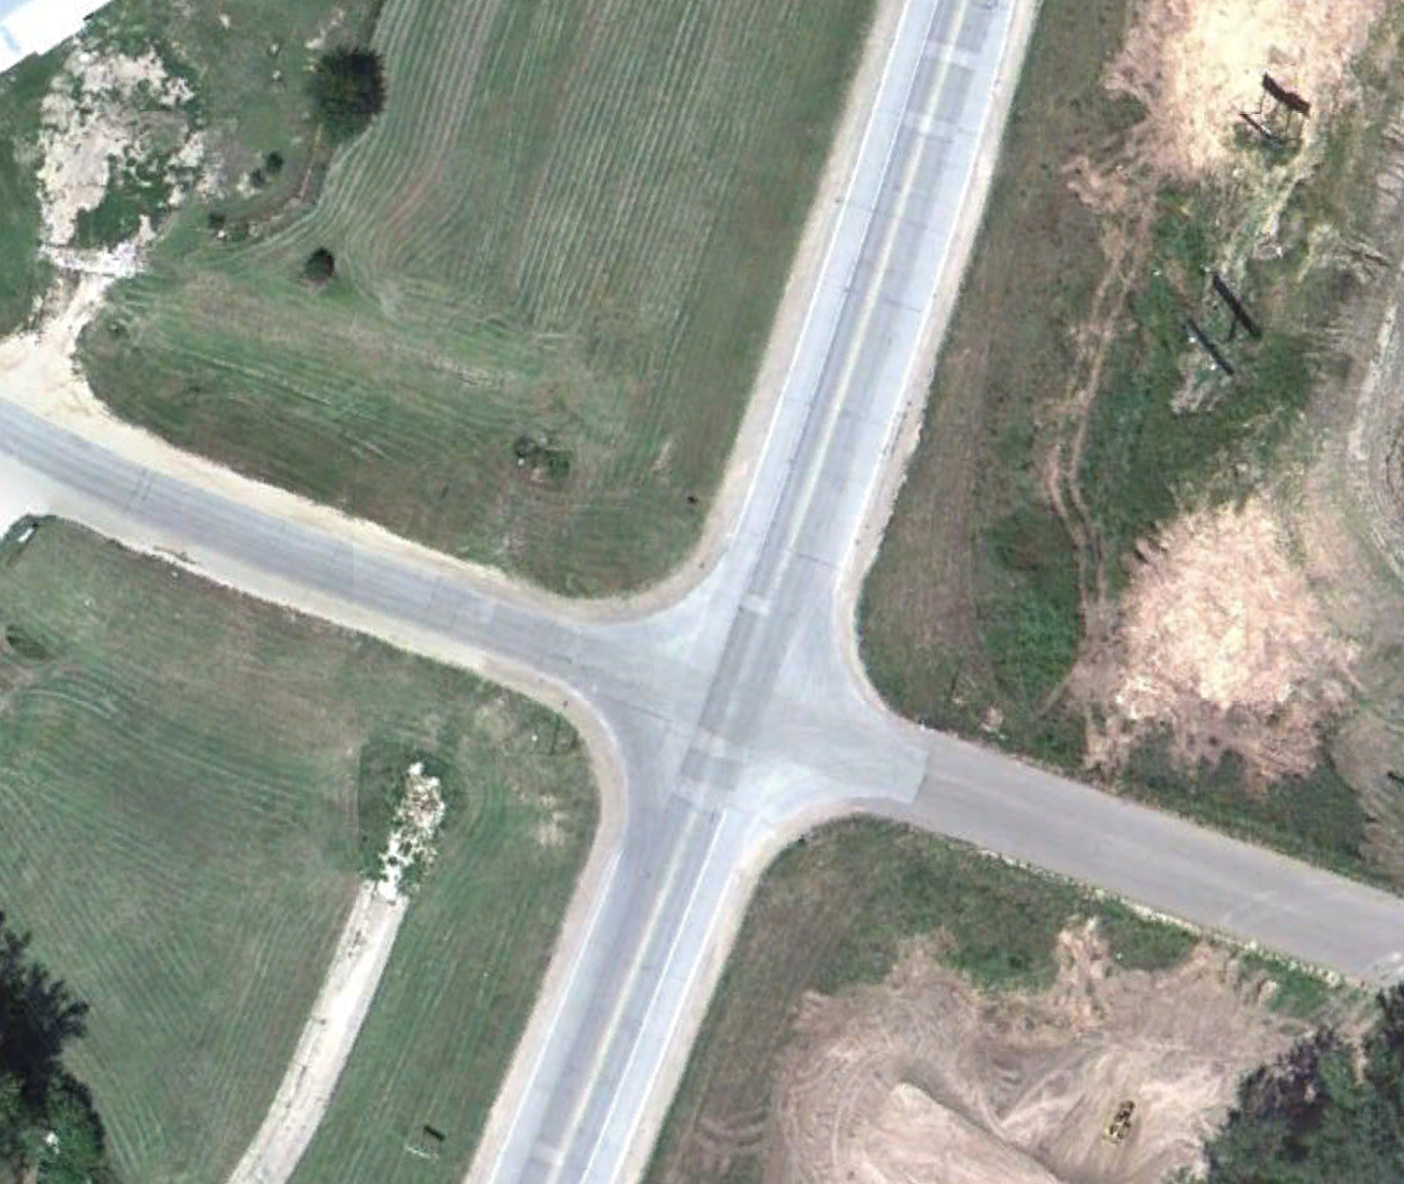
K18: Before & After
Miller Pkwy
Scenic Dr
Walnut St

Slide 18
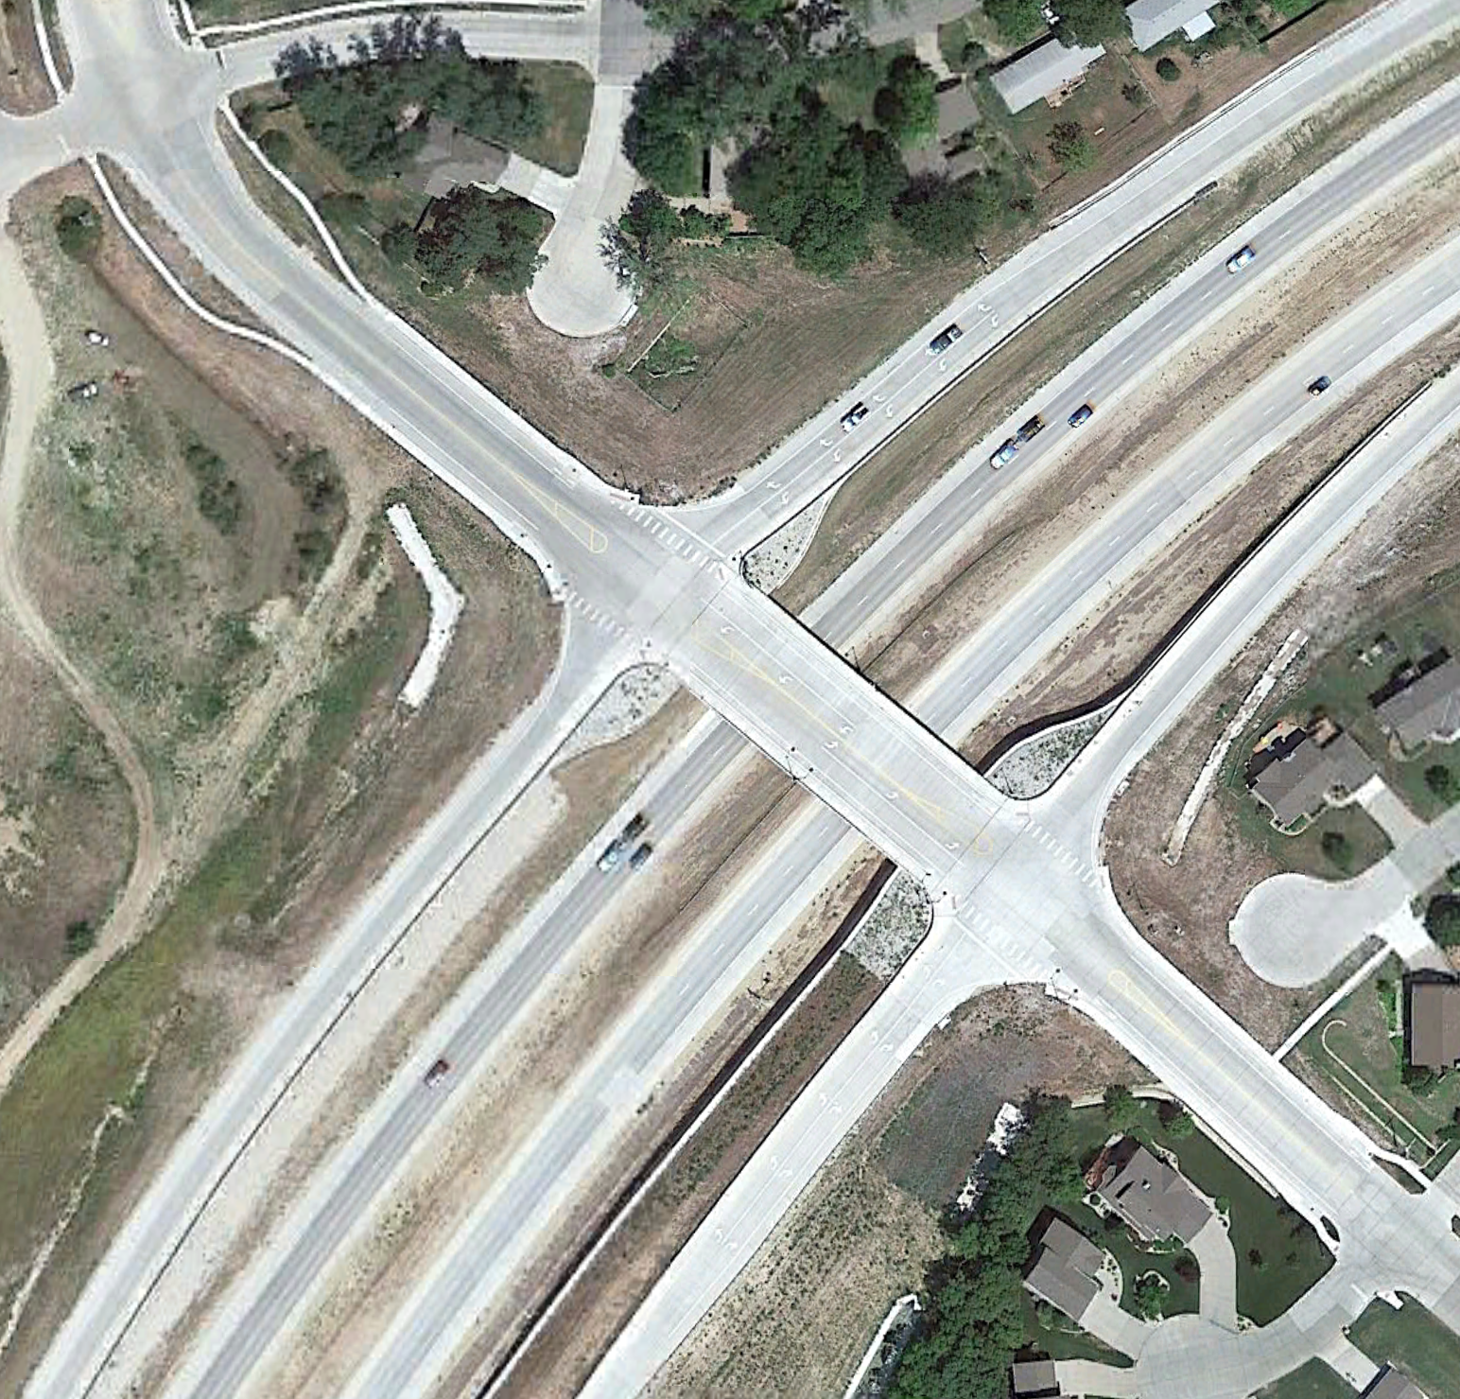
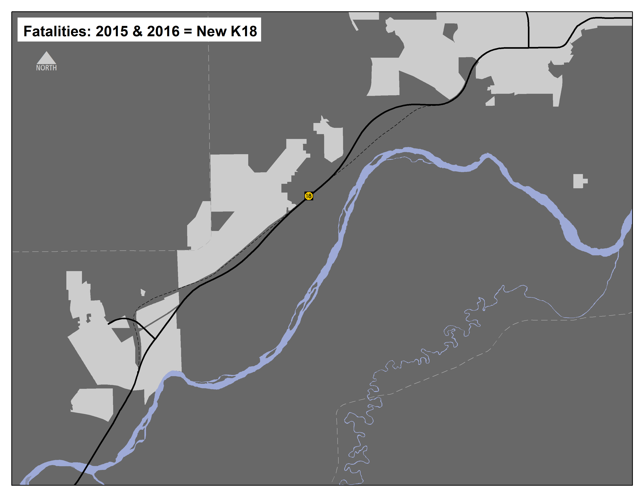
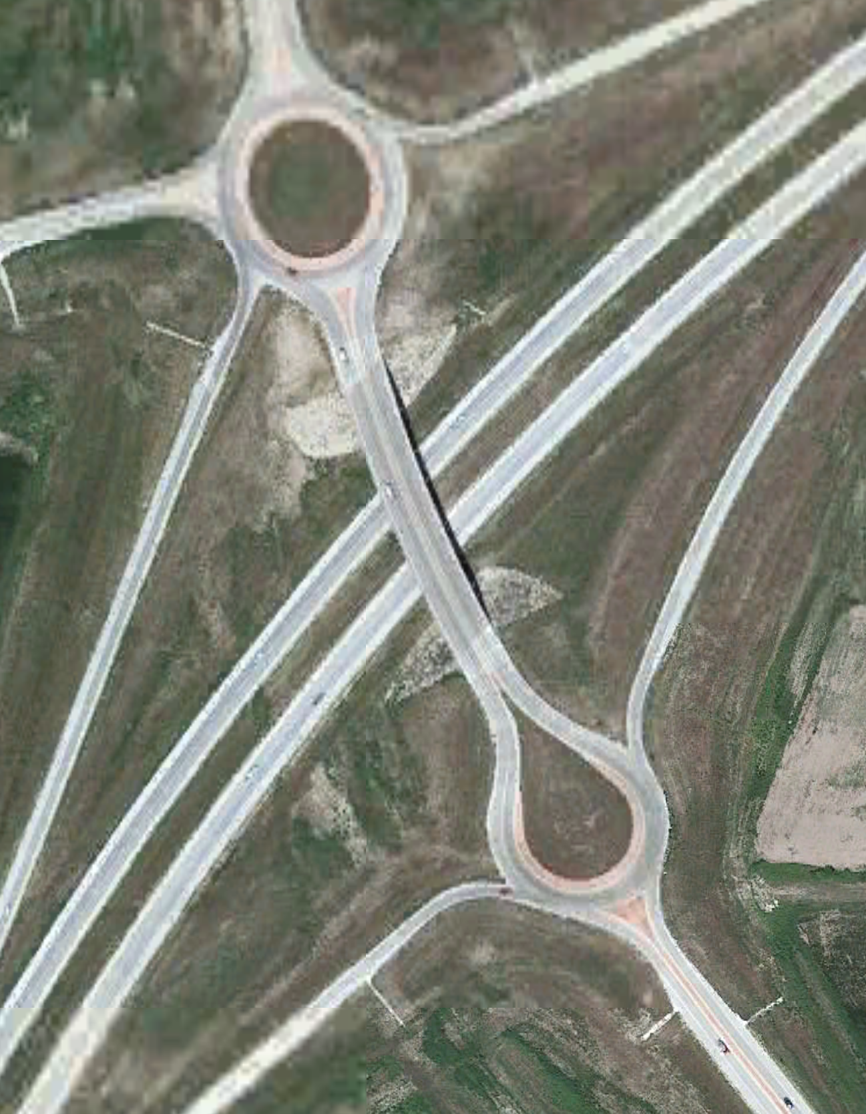
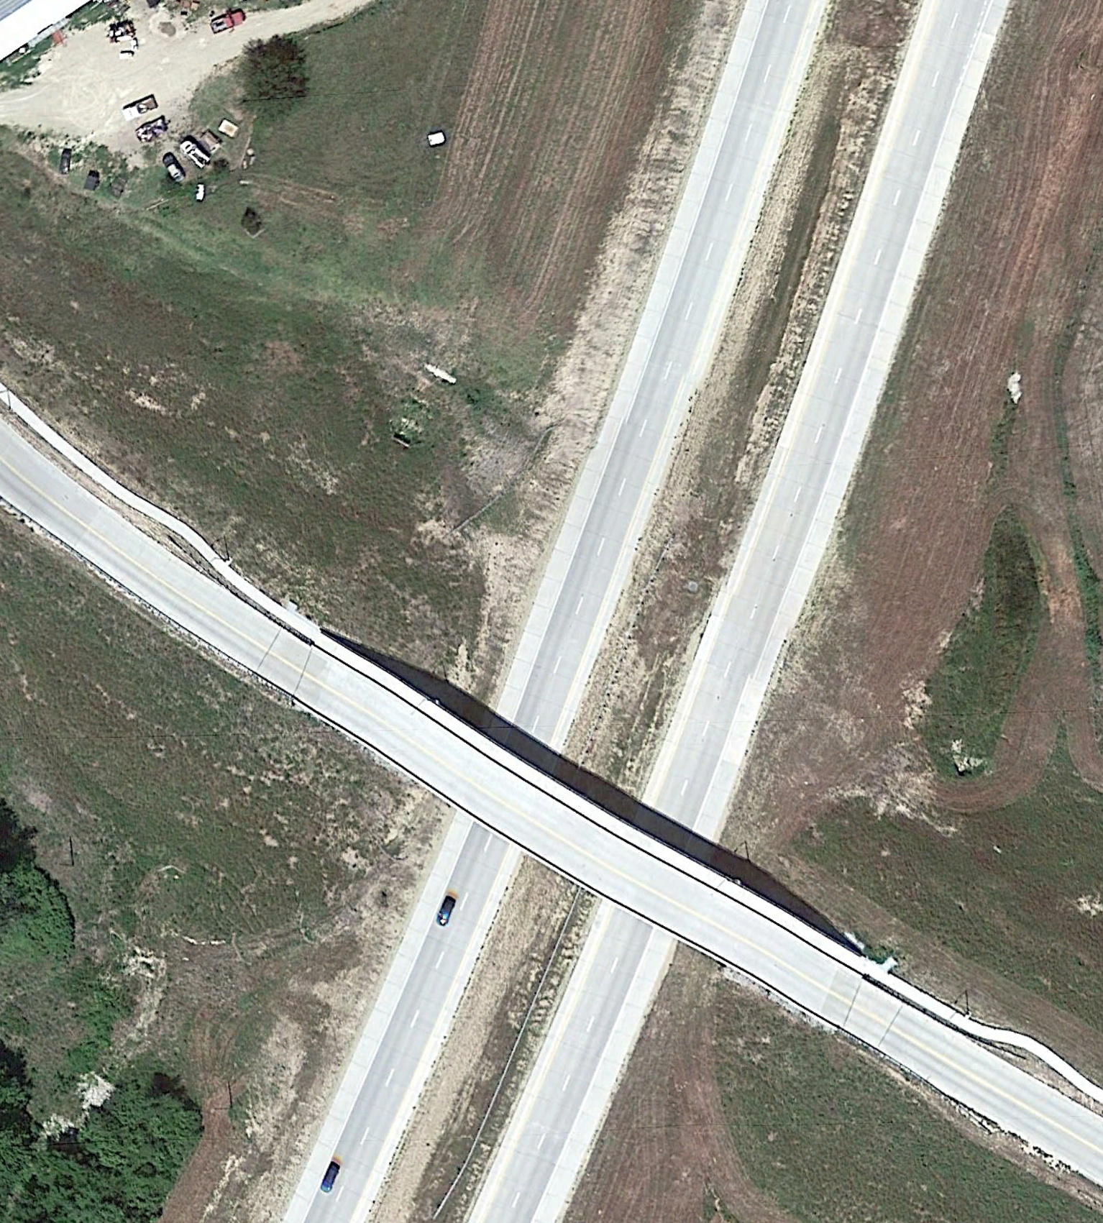
K18: Before & After
Miller Pkwy
Fatalities: 2015-2021 = New K18
Scenic Dr
Walnut St

Slide 19
K18: Before & After
Years | Road Type | # of Crashes | Crashes p. Year | # of Fatalities | Fatalities p. Year | # of Serious Injuries | Serious Injuries p. Year
2004-10 | 4-Lane | 676 | 96.5 | 9 | 1.29 | 40 | 5.71
2015-21 | 4-Lane Limited Access | 428 | 61.1 | 4 | 0.57 | 11 | 1.57
37% Reduction
56% Reduction
73% Reduction

Slide 20
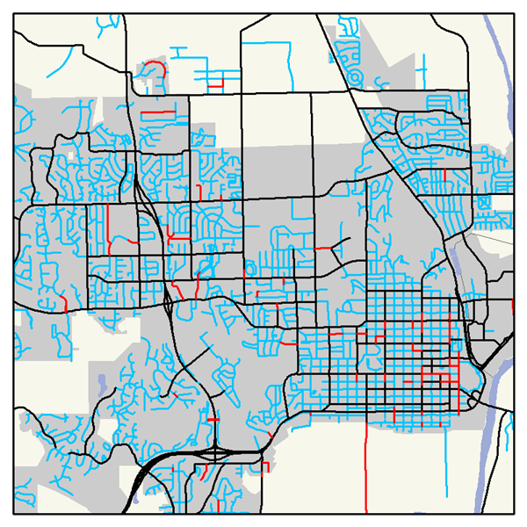
Appendix A
Calculating VMT
1. Calculate ADT for all Road Segments
Tube Counts
Zoning Sub-groups
TDM
Major Roads;
Skeleton network
Verify
KDOT
Rural Subdivision
City of MHK
MHK Wards 1
City of JC
MHK Wards 2
RL County
Create
MHK Wards 3
Assign ADT to remaining roads
(4,439 segments)
PT County
Subdivision 1
Subdivision 2
Subdivision 3
Cul du Sac
Industrial
Commercial

Slide 21
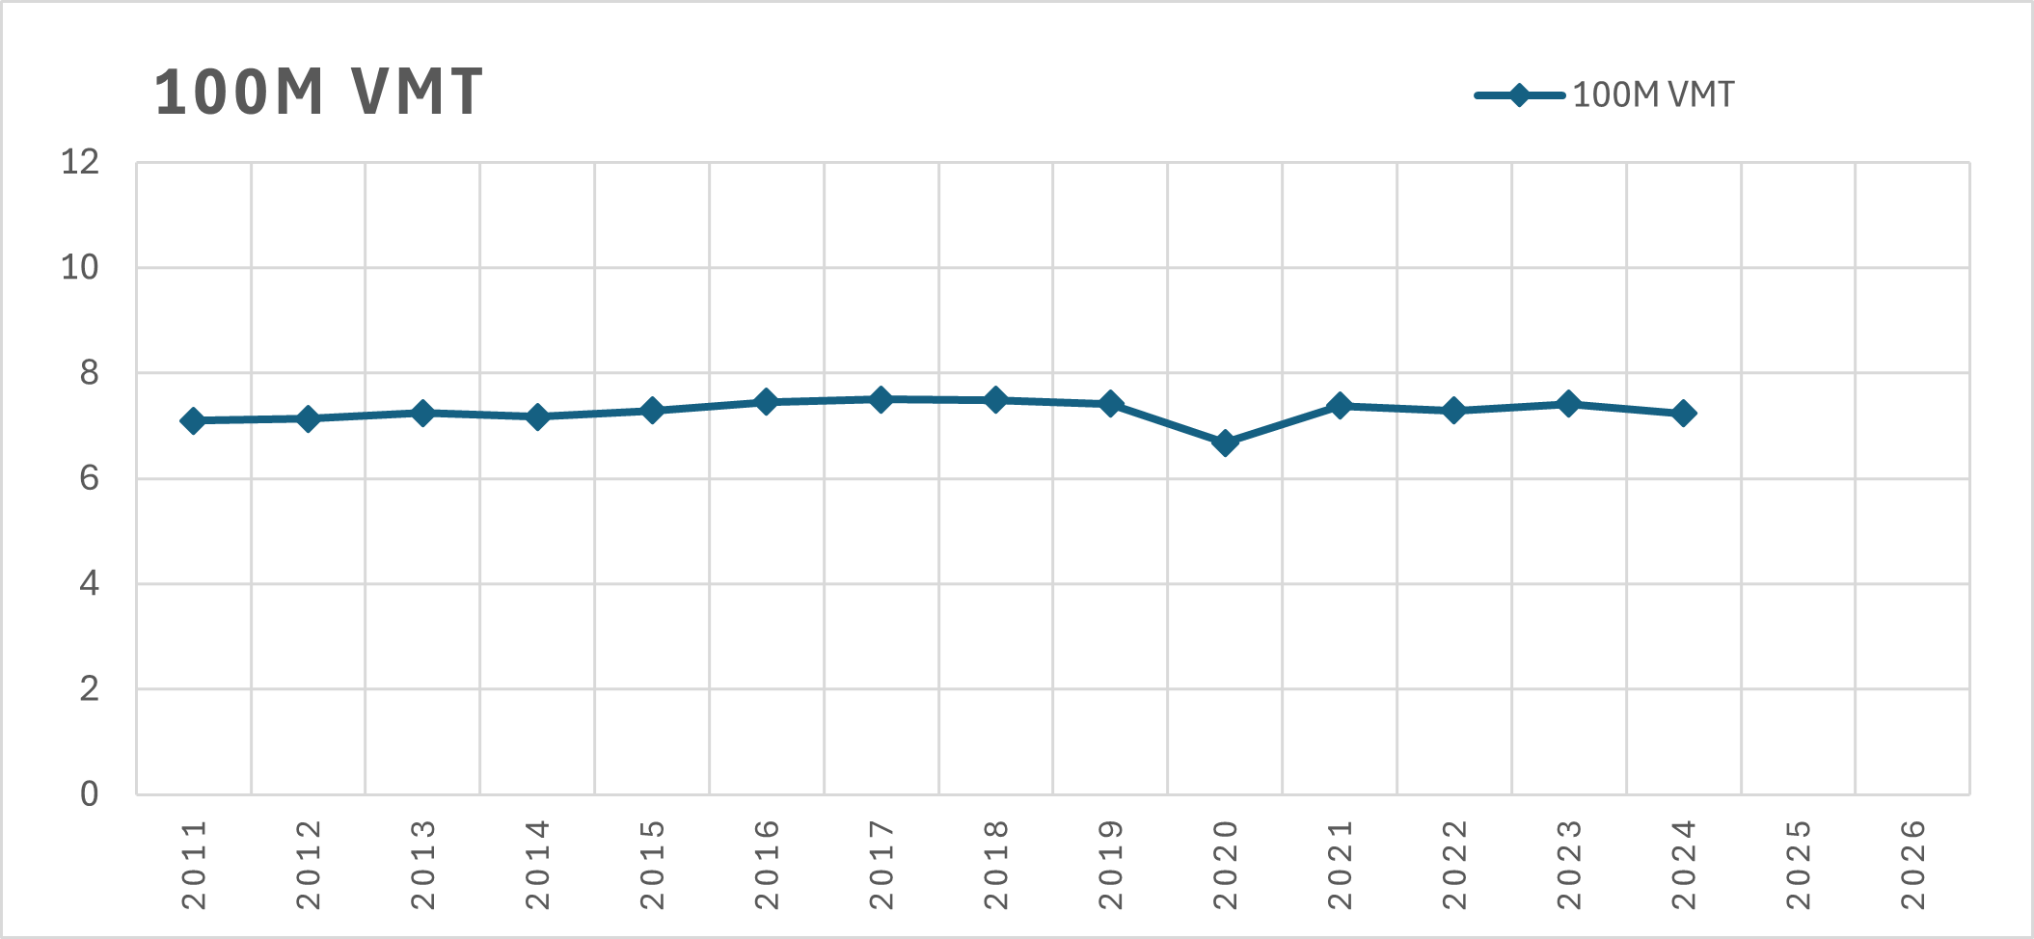
Appendix A
Calculating VMT
2. Calculate VMT from ADT for all Road Segments
(Road Length (ft) 5280) ADT = Daily VMT
365
Annual VMT
2016 VMT: 744,949,486
2024 VMT: 722,968,905
Annual % change based on KDOT data

